Slide 1
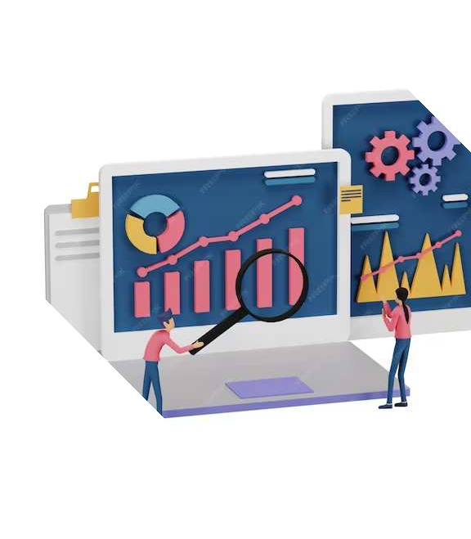
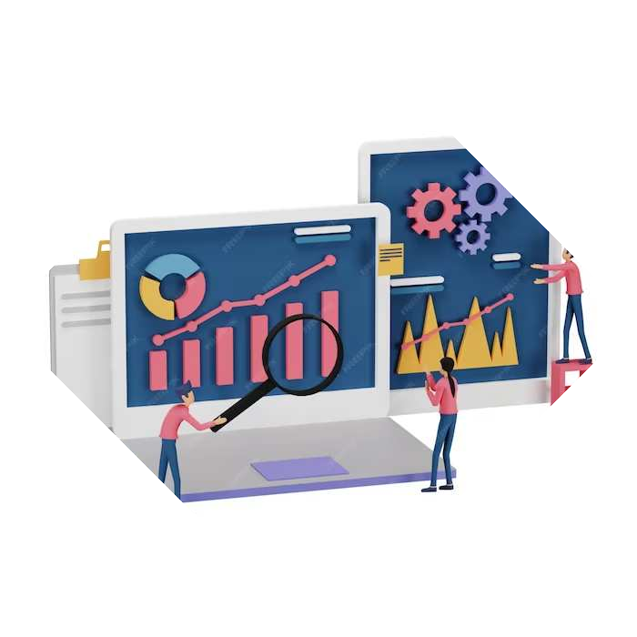
The Evolution of Personal Computers: From the First Desktops to Modern Laptops
Made by Kabai Koppány

Slide 2
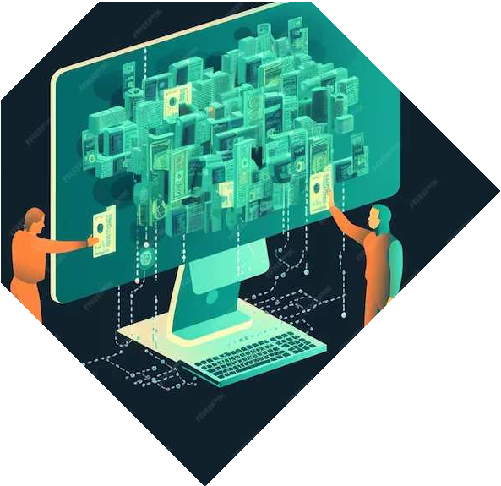
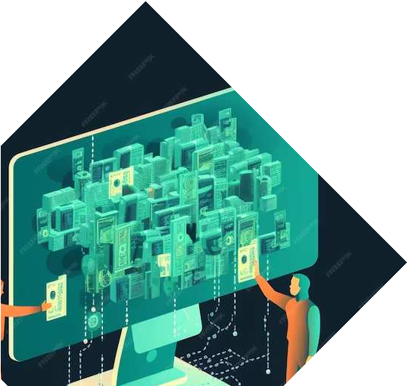
Introduction
The of personal computers has revolutionized the way we work and communicate. From the first to modern , the journey has been remarkable. This presentation explores the key milestones and innovations in the development of personal computers.

Slide 3
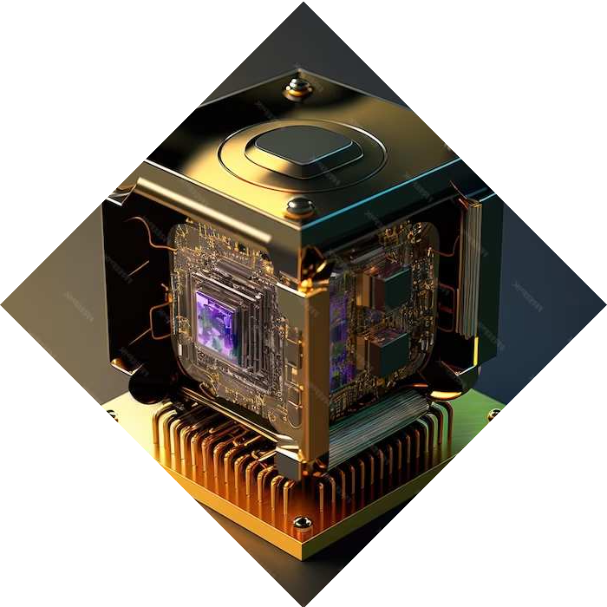
First Desktop Computers
The emergence of the first computers in the 1970s marked a significant milestone in personal
computing history. These early machines, such as the
and
, laid the foundation for the future of computing.

Slide 4
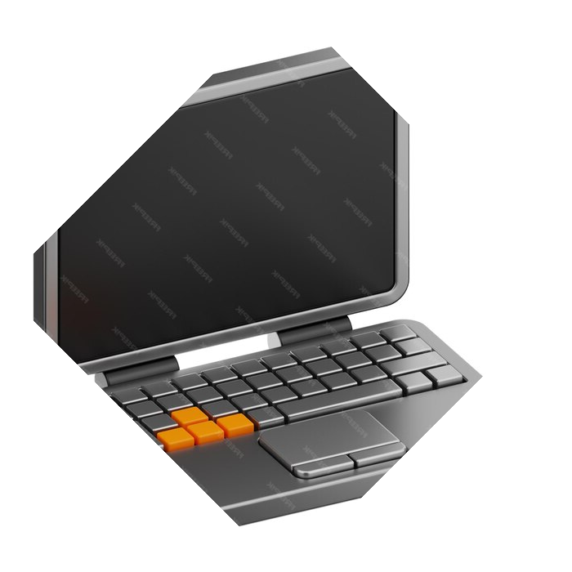

Rise of Portable Laptops
The development of
laptops in the 1980s and 1990s revolutionized personal computing.
Devices like the
and introduced
the concept of mobile computing, paving the way for the modern
laptop.

Slide 5
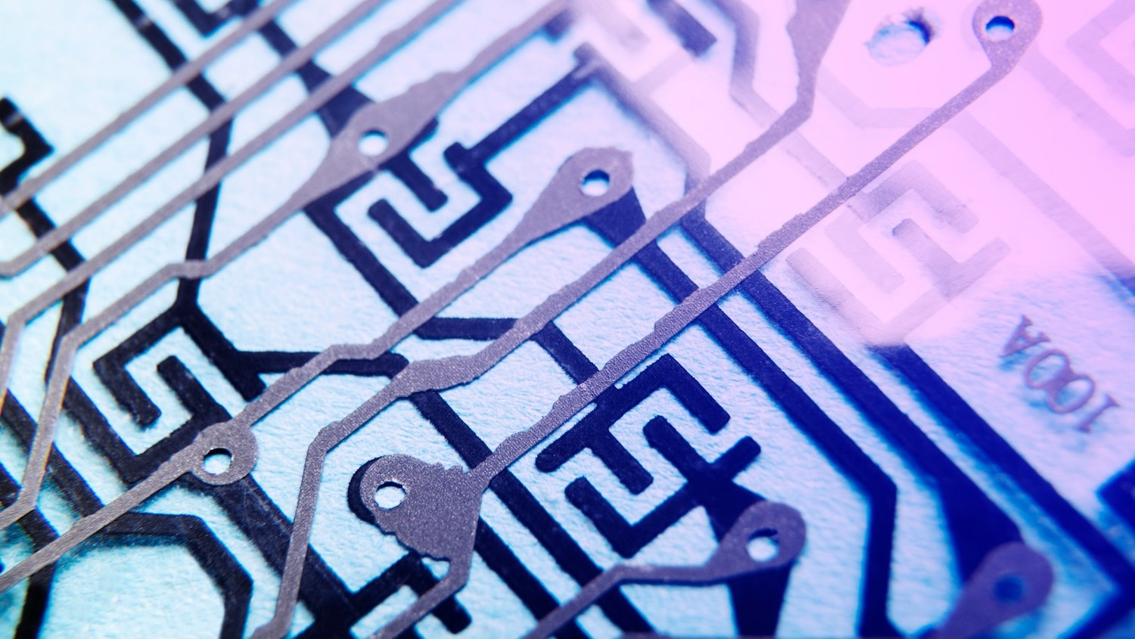

Advancements in Processing Power
The advancement of
has been a driving force in the evolution of personal computers.
From the introduction of the microprocessor to the latest
processors, computing capabilities have grown
exponentially.

Slide 6
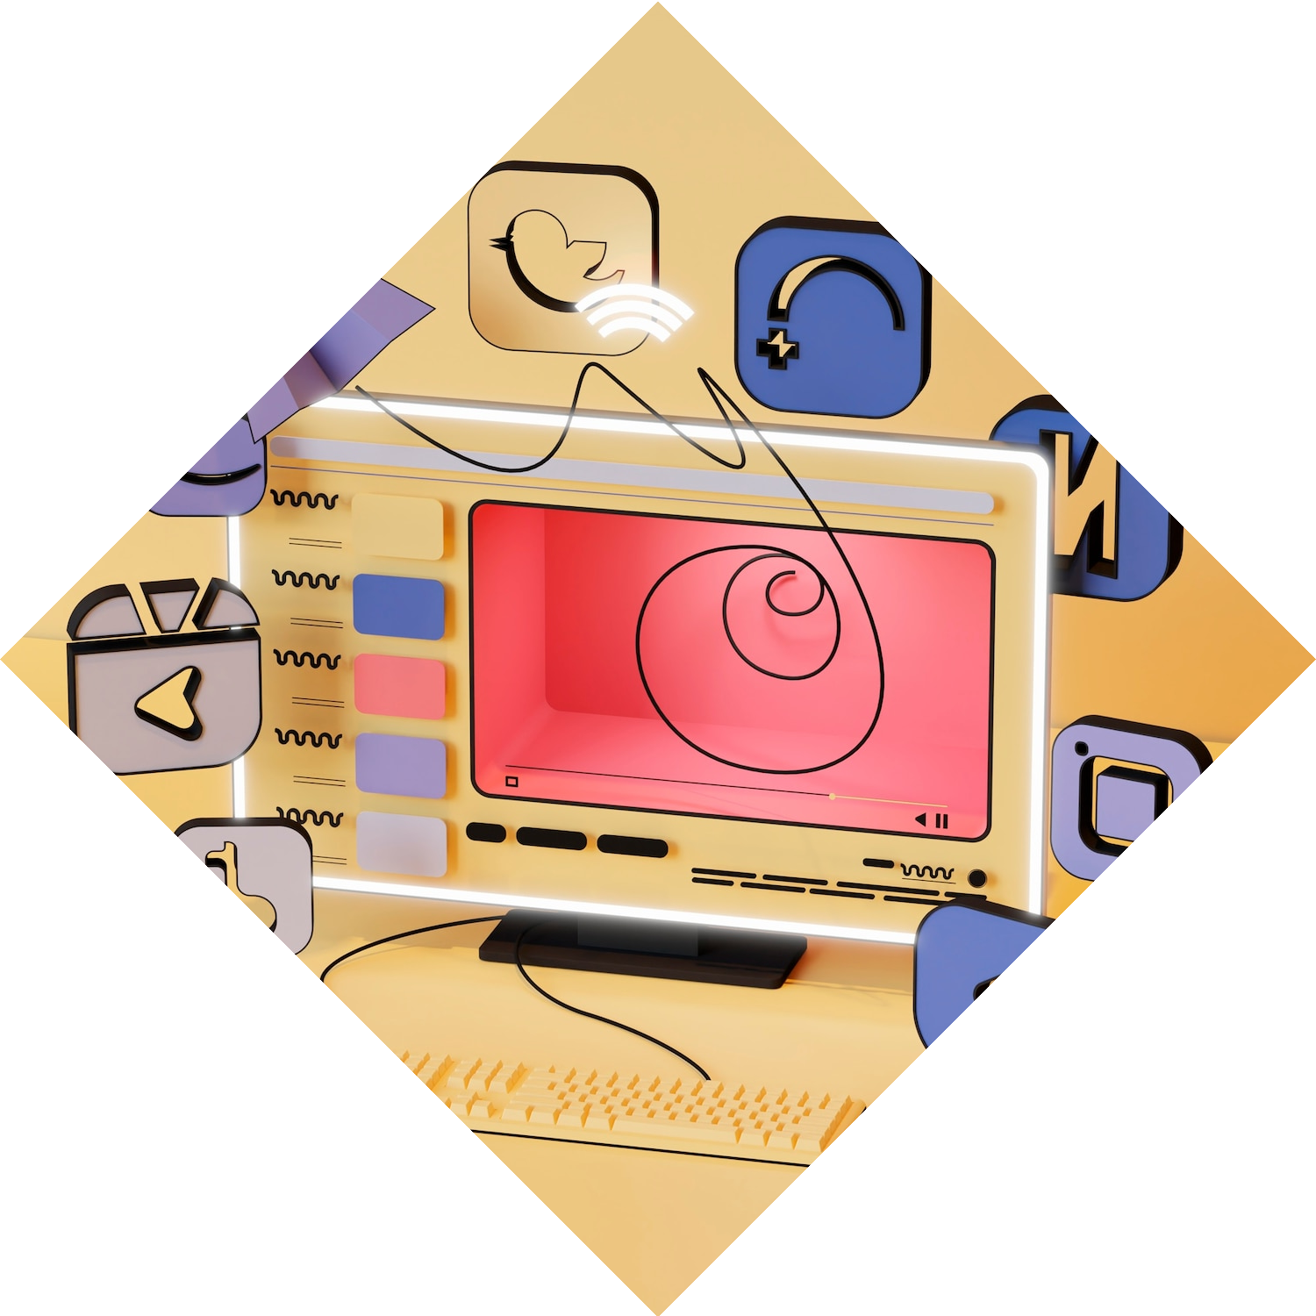
Integration of Multimedia Features
The integration of
features has transformed personal
computers into versatile entertainment and productivity tools. The addition of
, , and high-
resolution displays has enhanced
the user experience.

Slide 7
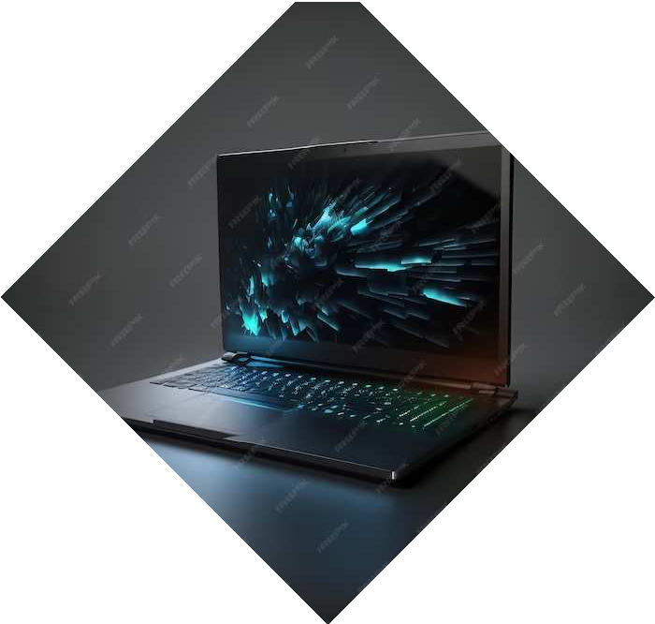

Modern Laptops and Beyond
Modern have become sleek, powerful, and portable devices that cater to diverse user needs. The integration of
, , and
advanced options has redefined the capabilities of personal computing.

